Slide 1
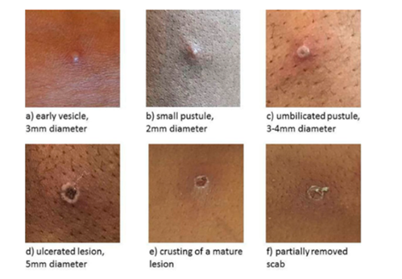
Pathway for Suspected Mpox CUH
There are two different clades (groups) of mpox virus- Clade I and clade II.
Clade I mpox is currently considered a high consequence infectious disease as it may be associated with higher morbidity and mortality and is potentially more transmissible.
Clade I mpox may require additional public health measures including transfer to the National Isolation Unit.
Inform laboratory staff of suspected clade I cases as additional precautions are required in the processing of all specimens.
Triage Nurse | Nurse in Charge/CNM3/ADON | ED Consultant/Registrar
Don PPE as per Point of care risk assessment including FFP2/ FFP3 Mask and eye protection Consider mpox if a patient has one or more of the following: Unexplained recent onset rash which may include single or multiple lesions in the ano-genital region or elsewhere on the body Mucosal lesions-single or multiple lesions which may be oral, conjunctival, urethral, penile, vaginal or anorectal Proctitis (rectal pain/tenesmus/rectal bleeding) One or more classical symptoms(s) of mpox (monkeypox) infection-acute illness with fever, headache, myalgia, arthralgia, back pain, lymphadenopathy, asthenia, fatigue And one of more of the following: Travel history to countries with confirmed Clade I Mpox virus (DRC, Republic of Congo, Central African Republic, Burundi, Rwanda, Uganda, Kenya, Cameroon and Gabon) or a risk of Clade I virus (Angola, South Sudan, Tanzania, and Zambia) OR An epidemiological link to a confirmed or probable case of mpox from the above countries in the 21 days before symptom onset OR Reports a change in sexual partners in the 21 days prior to symptom onset, regardless of sexual practice Refer to HPSC algorithm for most up to date epidemiological links Contact nurse in charge of ED to arrange isolation | Transfer patient via isolation ‘covid’ entrance to decontamination room Apply standard, contact and airborne precautions Liaise with ED consultant/registrar for expedited assessment Contact infection control (in hours) or Consultant Microbiologist on call (out of hours) | Assess patient in required PPE including FFP2 mask, long sleeved gown, gloves & eye protection If clinical history suggests clade I mpox (History of contact with known clade I, travel history to country with risk of clade I exposure) immediately contact the National Isolation Unit as further infection control precautions (high consequence infectious disease measures) +/- transfer to the NIU may be required Inform public health dept. if suspected clade I mpox. Phone number: 021 4927601 Test for mpox if deemed necessary following clinical assessment Use viral swab in viral transport medium (red topped swab) Swab a cutaneous lesion (ulcer/vesicular fluid), if there are no cutaneous lesions a throat swab may be taken Clearly label the sample, double bag at the site of collection and take to the microbiology lab. Inform laboratory staff of suspected clade I mpox. Do not use the pod transport system If patient is for admission to CUH -Inform nurse in charge -Inform Bed Management -Contact microbiology consultant on-call regarding isolation -Liaise with the infectious diseases team
www.hpsc.ie/a-z/zoonotic/monkeypox/guidance/
Version 3.0 15/10/2024
Approved IPCC 18.10.24

